Slide 1
Too Young for Menopause
Helping Young Women with Breast Cancer manage Menopause

Slide 2
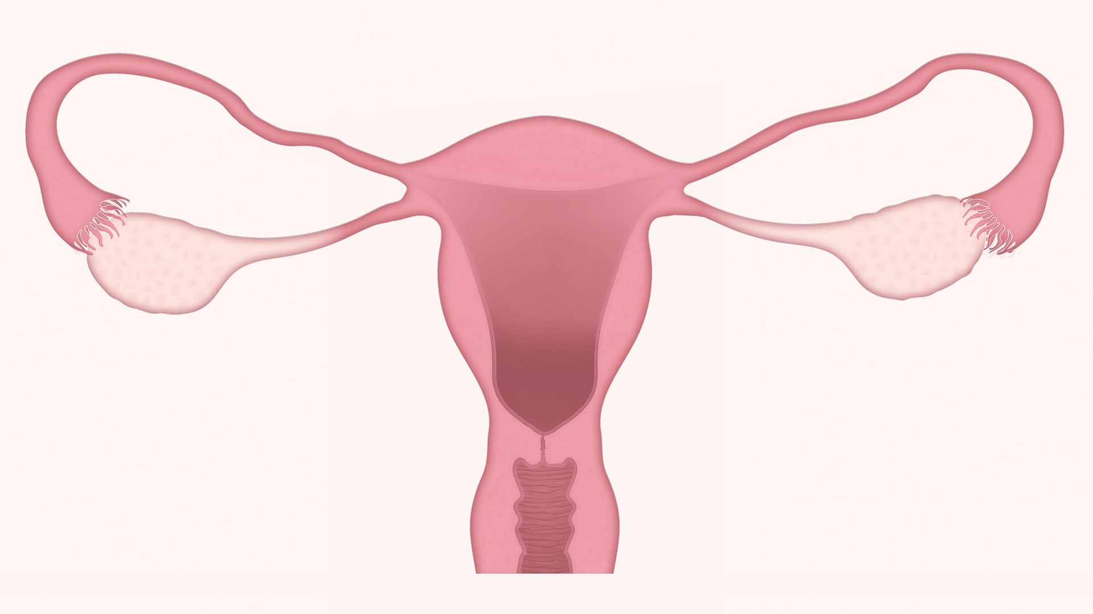
Menopause
Natural Menopause
Gradual
Average age 51 years
Symptoms usually mild
Peer support
Treatment-Induced Menopause
Sudden
Any age
Symptoms often severe
No peer support

Slide 3
Treatment induced Menopause
Chemotherapy
Hormonal Therapies
Chemotherapy damages ovaries
Cyclophosphamide is most damaging of all
Can be Permanent or Temporary
ER positive breast cancers
Ovarian Suppression Lupron/Zoladex
Aromatase Inhibitors Exemestane/Letrozole/Anastrozole may worsen menopausal symptoms
Tamoxifen blocks the effect of estrogen
Symptoms can mimic menopause

Slide 4
Much More than Hot Flashes - 1
Hot flashes / Night sweats
Insomnia / sleep disturbance
Fatigue
Alterations in mood
On PYNK website: "Breast cancer and early menopause - a guide for younger women"
Menopause can change everything both physically and emotionally

Slide 5
Much More than Hot Flashes - 2
Decreased blood flow to the sexual organs
Diminishing pelvic floor tone
Vaginal dryness
Painful intercourse
Bladder infections
Decreased sex drive
Menopause can change everything both physically and emotionally

Slide 6
Decreased sex drive
Menopause leads to completely new neural pathway for arousal
Pre menopausal vs. post menopausal
Additional physical and psychological causes of decreased sex drive:
Fatigue
Poor Body Image
Depression and anxiety
Communication breakdown

Slide 7
Need for Action

Slide 8
The Tool Kit
Every young woman with breast cancer should have one…

Slide 9
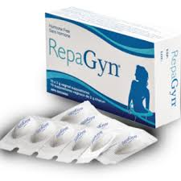
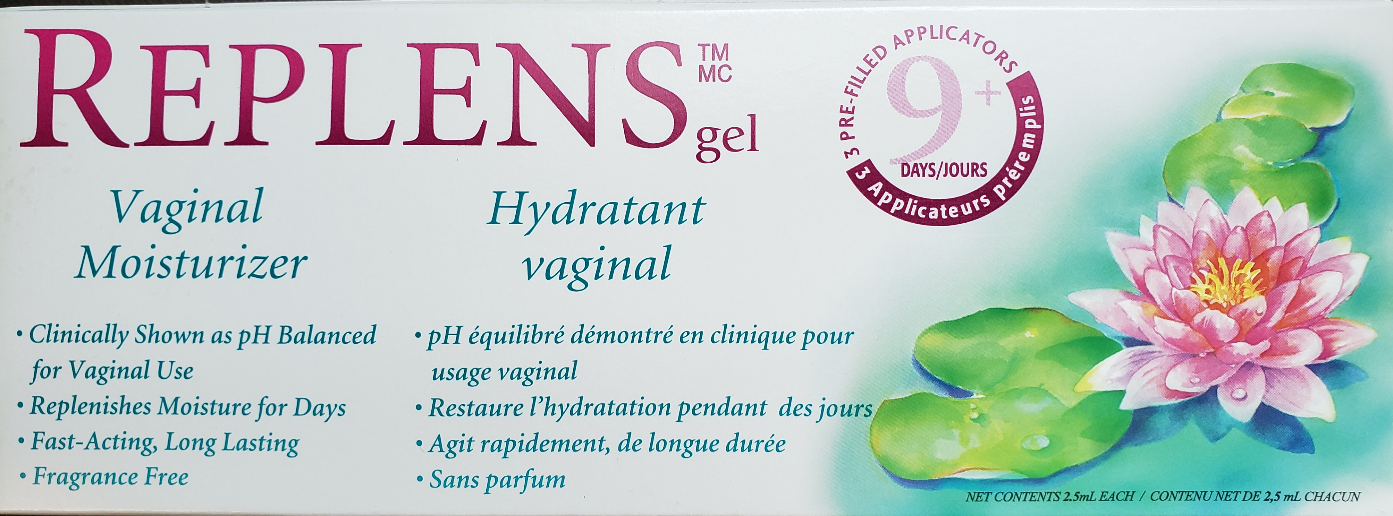
Vaginal moisturizers
Begin moisturizing before symptoms appear
Methods of application: ovules, creams, creams with applicators
Replens, RepaGyn, Gynetrof
Experiment
Why so “goopy”?
External genitalia too
No products containing hormones

Slide 10
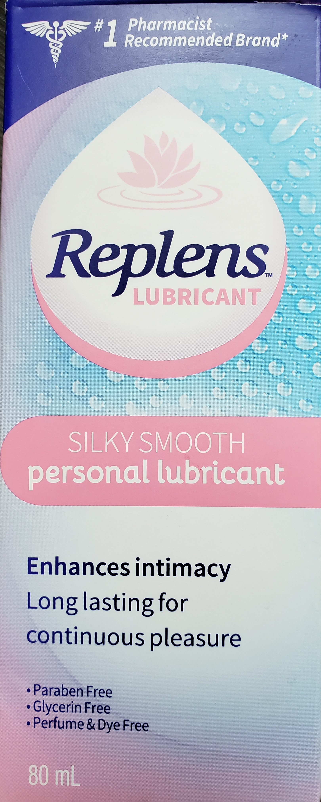
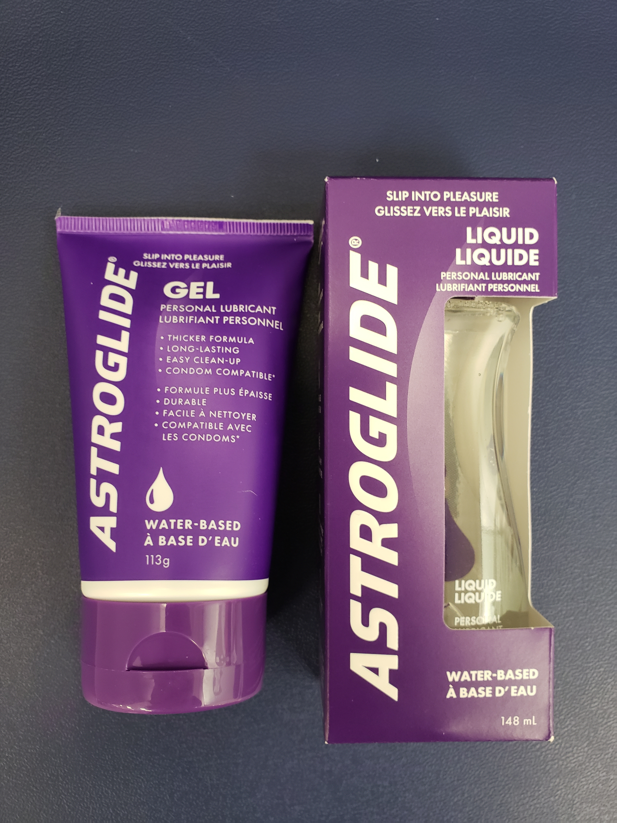
Vaginal lubricants
Many young women are familiar with vaginal lubricants used during sexual intercourse
Slippery and ease penetration
Recommend water based, unflavoured and no sensation

Slide 11
Vaginal dilator kit
Decrease in estrogen leads to shortening, narrowing of vaginal canal
Silicone set comes with 5 dilators of different lengths and calibers
Start at size which does not cause pain
Use lots of lubrication

Slide 12
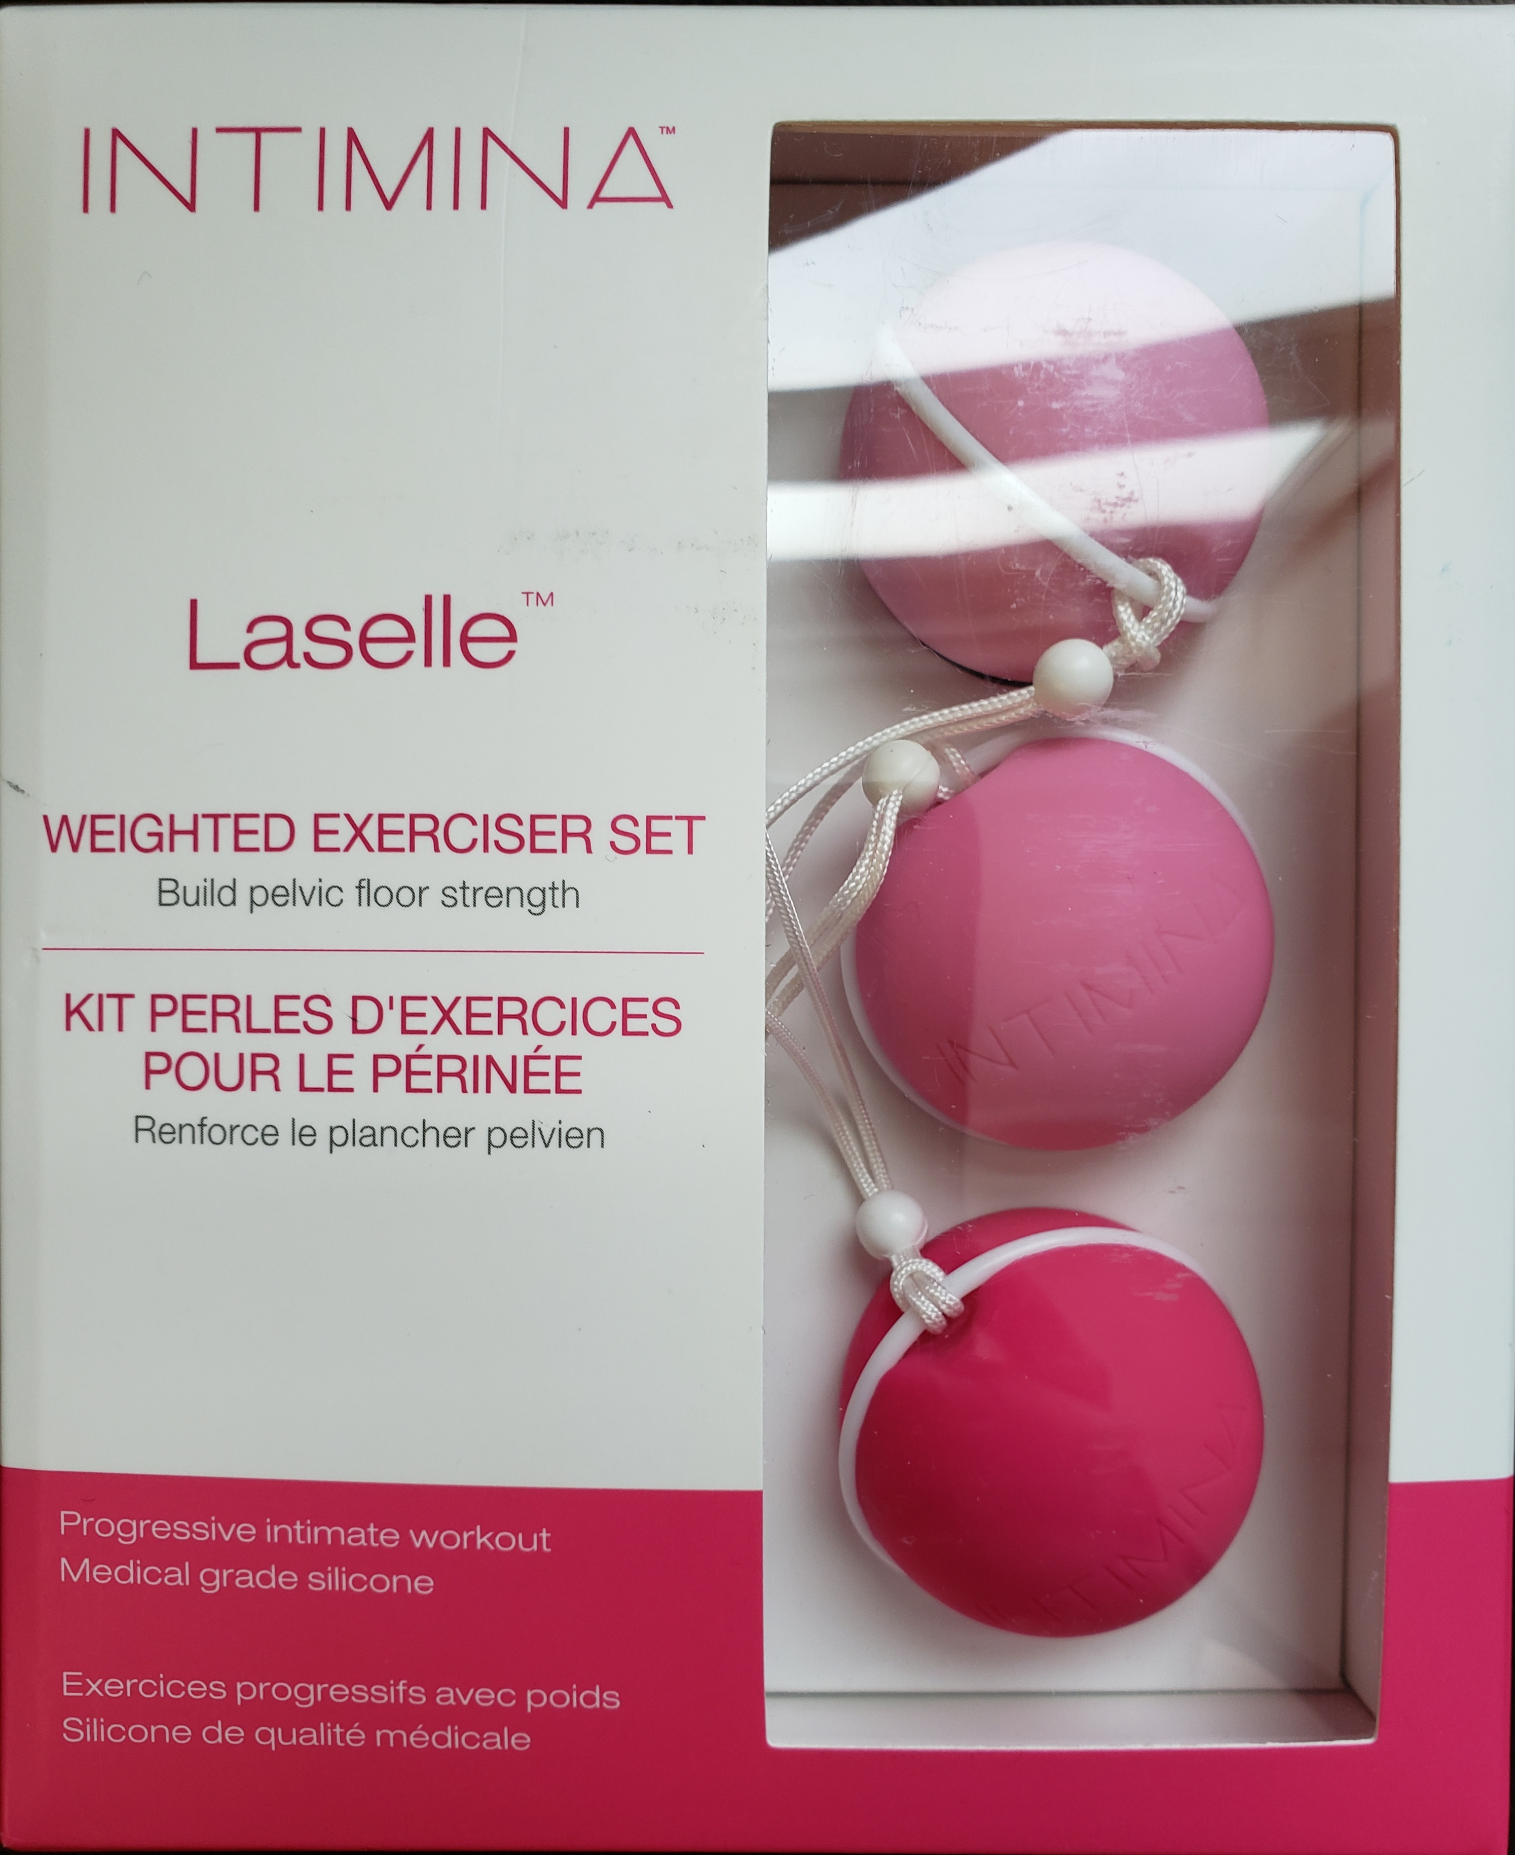
Pelvic floor exercises - Kegels
Exercise pelvic floor muscles
Bring better blood flow to the vaginal tissues and tighten the pelvic girdle
Target small area
Repetition makes stronger
Dilator/Kegel balls may be helpful

Slide 13
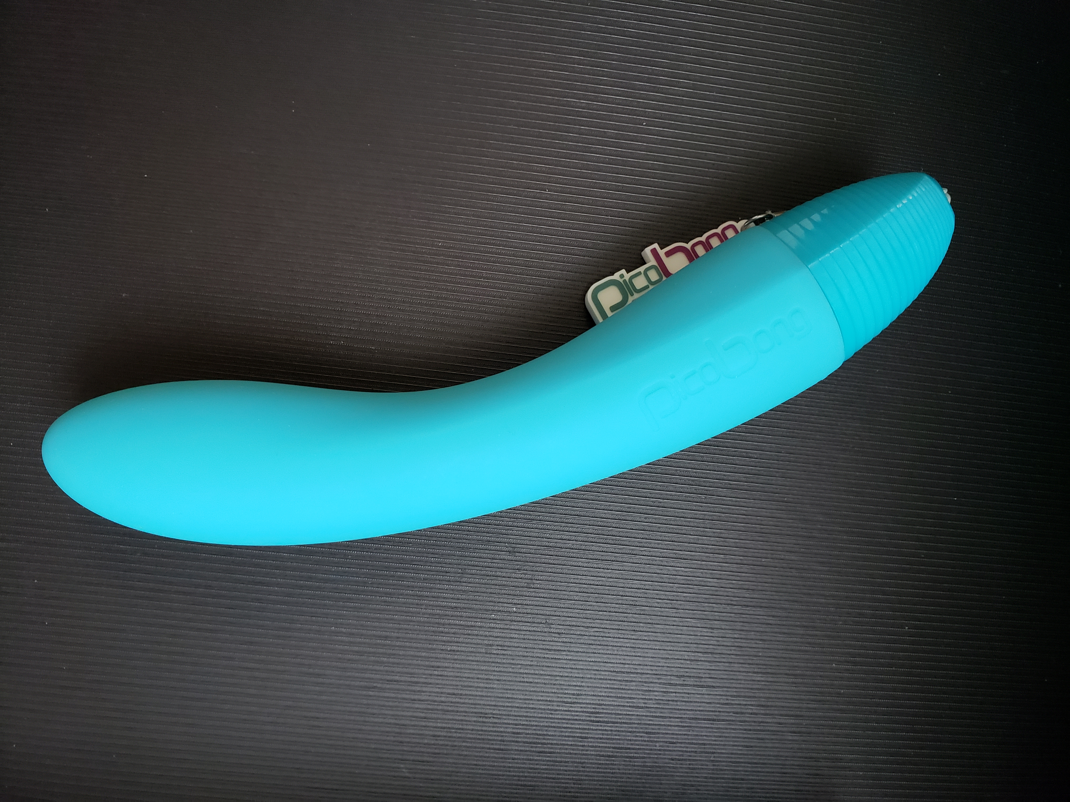
Vibrators
Internal massage tool that brings extra blood to the pelvis
Brings further healing to the area
Can help you learn what feels good and what doesn’t
www.goodforher.com
www.comeasyouare.com

Slide 14
Order of interventions
Vaginal moisturizer
Dilator with Lubricant
Kegels with or without dilator
Vibrator?

Slide 15
Professional help
Physiotherapist specialized in treatment of pelvic structures
Talk therapy
individual
couple

Slide 16
Thank You for your attention!

